Slide 1
IPv6 protocol :
❑ Larger address space.
An IPv6 address is 128 bits long. Compared with the 32-bit
address of IPv4, this is a huge increase in the address space.
❑ Better header format.
IPv6 uses a new header format in which options are separated from the base header and inserted, when needed. This simplifies and speeds up the routing process because most of the options do not need to be checked by routers.
❑ New options.
IPv6 has new options to allow for additional functionalities.
❑ Support for more security.
The encryption and authentication options in Ipv6 provide confidentiality and integrity of the packet.

Slide 2
ipv4

Slide 3
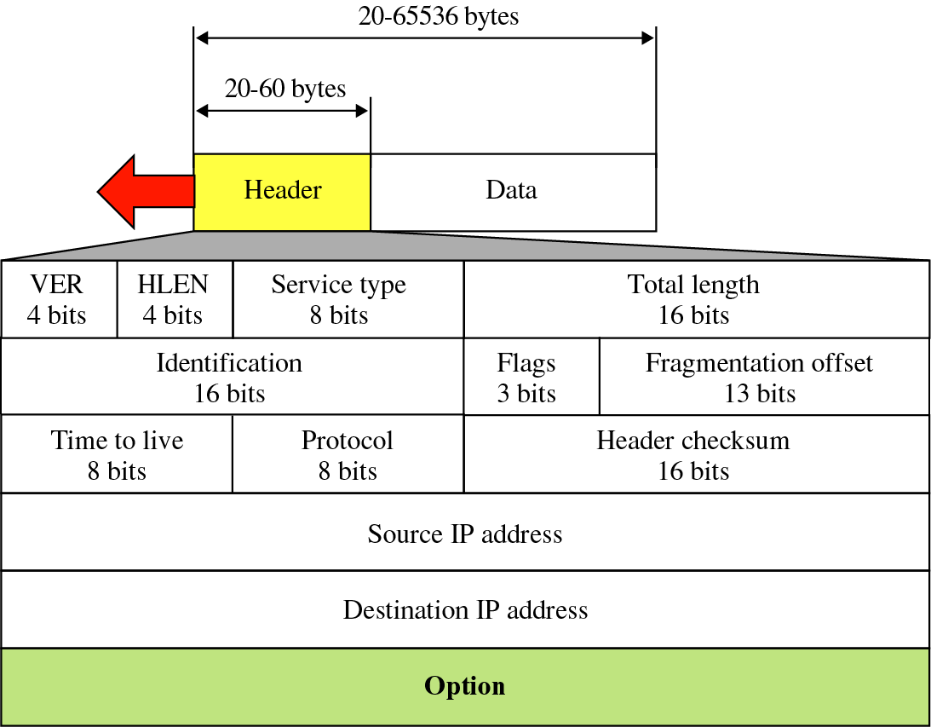
Figure 8-2
IP datagram

Slide 4
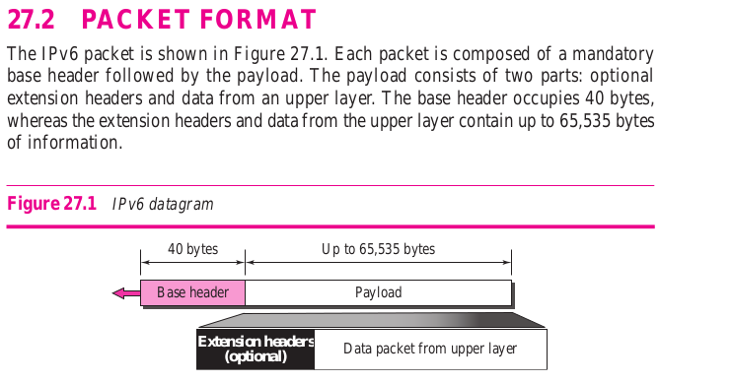

Slide 5
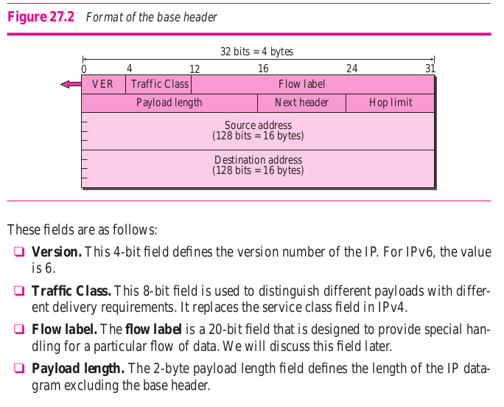

Slide 6
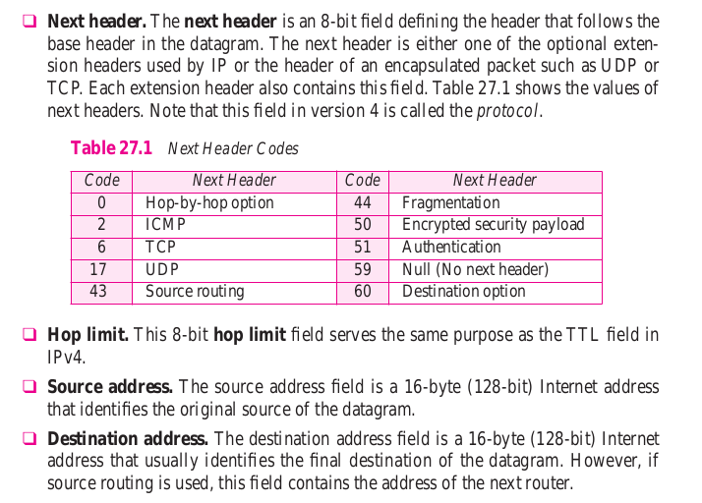

Slide 7
Flow label
To a router, a flow is a sequence of packets that share the same characteristics, such as traveling the same path, using the same resources, having the same kind of security, and so on.
A router that supports the handling of flow labels has a flow label table.
The table has an entry for each active flow label; each entry defines the services required by the corresponding flow label.
When the router receives a packet, it consults its flow label table to find the corresponding entry for the flow label value defined in the packet.
It then provides the packet with the services mentioned in the entry.

Slide 8
In its simplest form, a flow label can be used to speed up the processing of a packet by a router.
When a router receives a packet, instead of consulting the routing table and going through a routing algorithm to define the address of the next hop, it can easily look in a flow label table for the next hop.

Slide 9
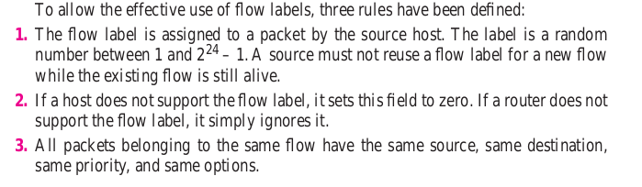

Slide 10
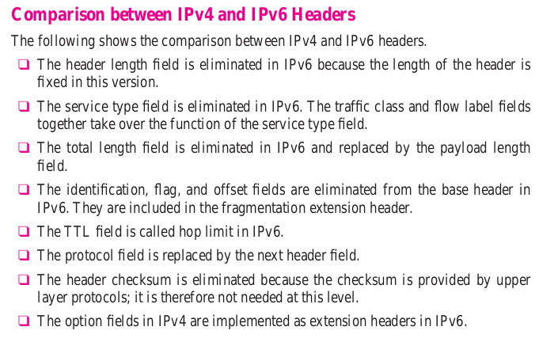

Slide 11
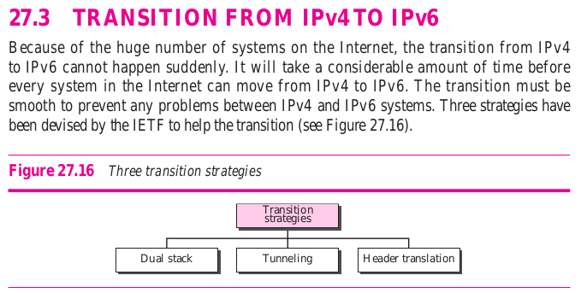

Slide 12
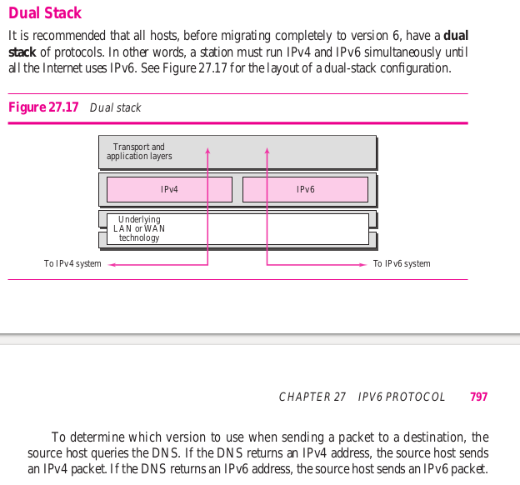

Slide 13
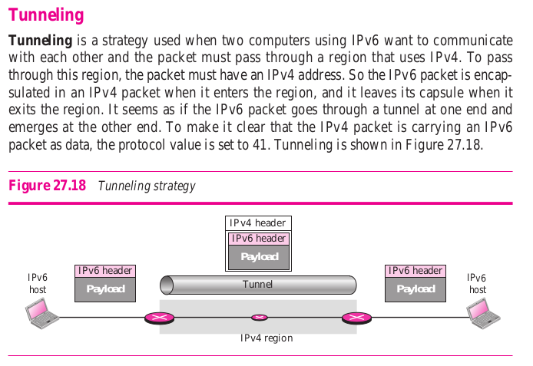

Slide 14
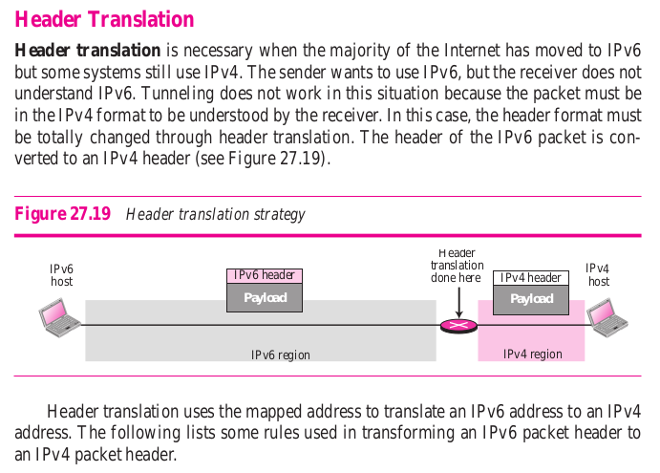

Slide 15
